Slide 1
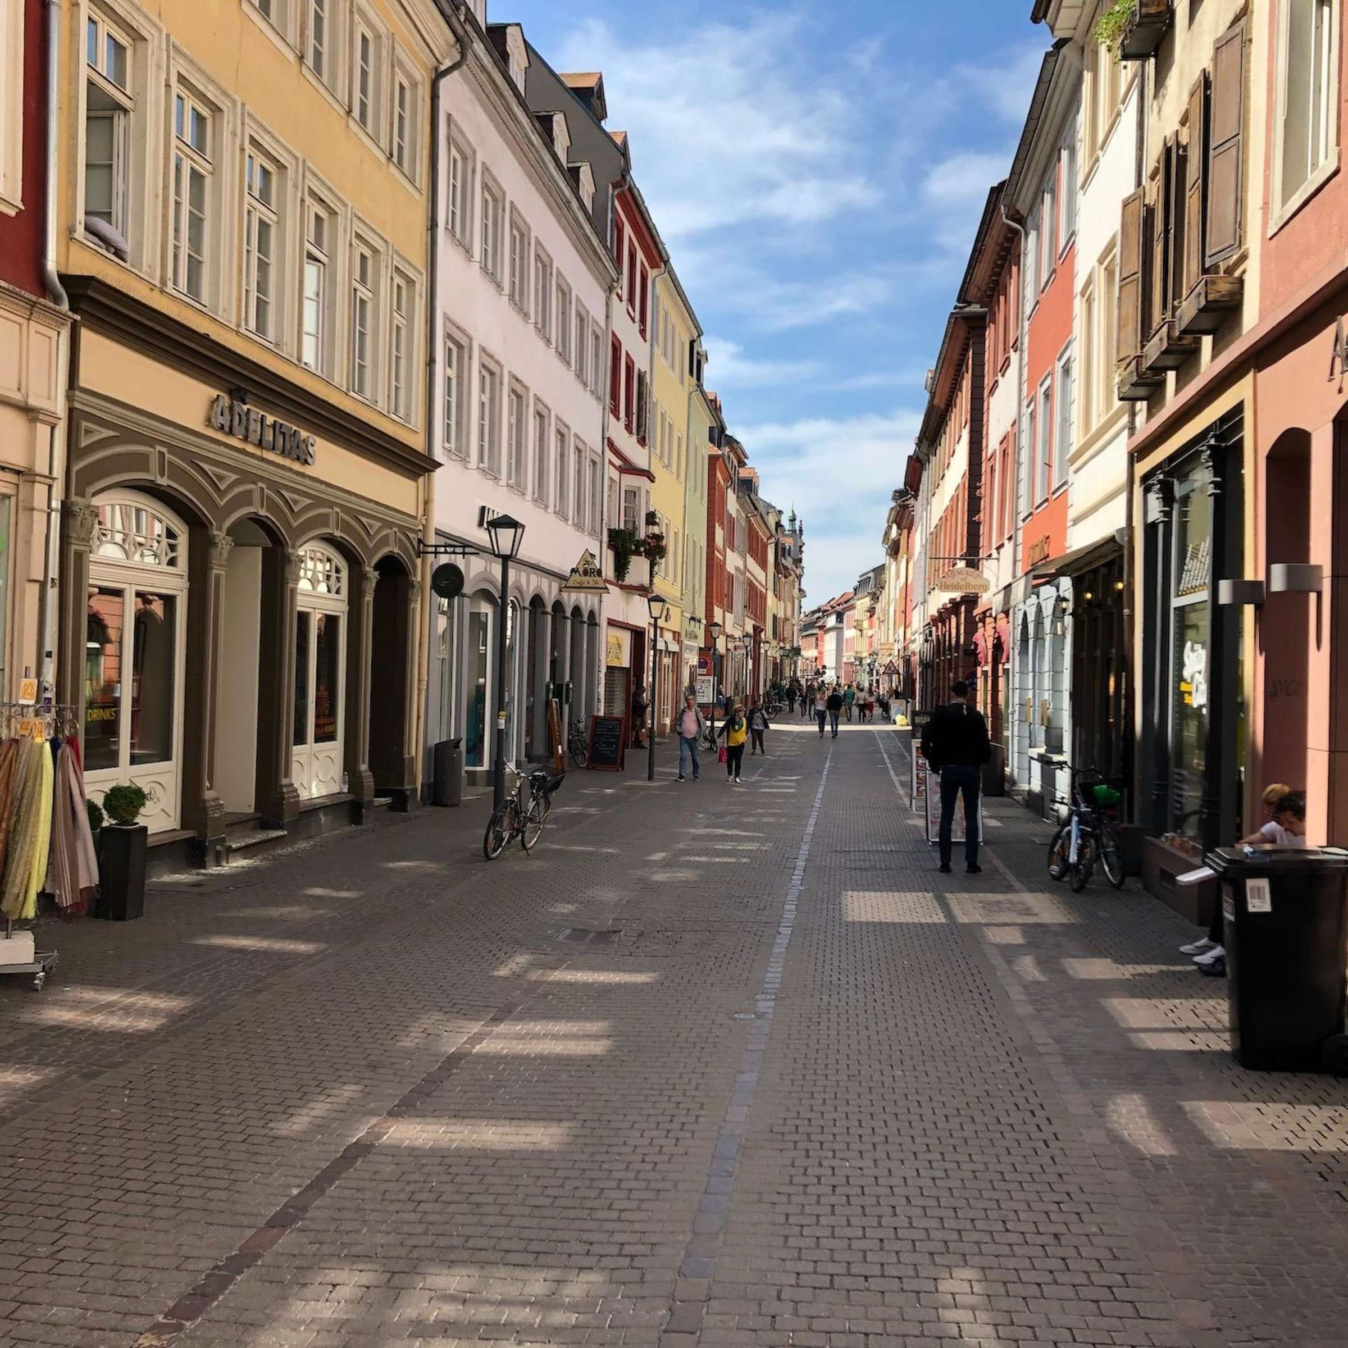
SRH 2021 HEIDELBERG FÜR SIE
Team 2
Bhushan Sakhalkar
Ashwini Sarode
Smruti Puranik
Zeba Gunjarge
Amadou Gueye
Mobile application
Presented on
10.05.2021

Slide 2
Content
01
Introduction
07
User Stories
13
Cost Estimation
02
Problem Statement
14
Technological Aspect
08
Application Flow Chart
03
09
User Interface
Market Research
04
10
Risk Analysis
Requirements
05
11
Stakeholder Analysis
Target State
06
Moscow
12
Milestones
10.05.2021
2

Slide 3
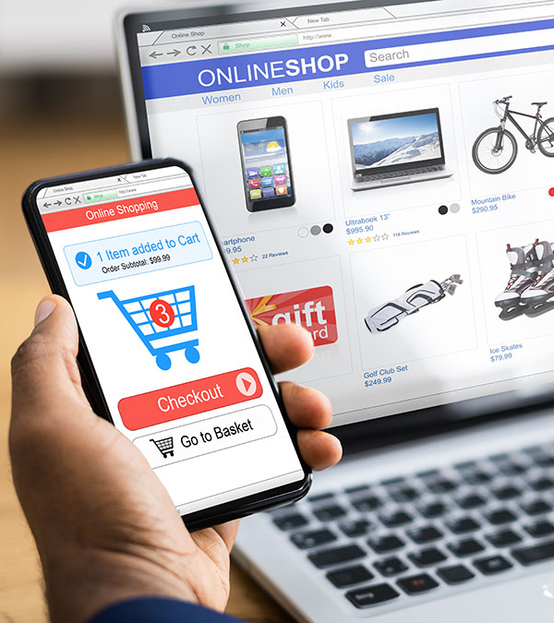
HEIDELBERG FÜR SIE
Introduction
HEIDELBERG FÜR SIE is an application designed specifically for the citizens of Heidelberg to have their own e-platform where they can easily find the information about each shop and service provided in Heidelberg.
10.05.2021

Slide 4
Problem Statement
Adaption to the digital world is one of the keys to a successful business as offline businesses have experienced a drastic downfall in recent years. The shop owners and service providers in Heidelberg must start adapting to the online e-commerce world to flourish their business economically. Not having a central logistics in place has created a chaos in turn affecting the environment.
10.05.2021

Slide 5
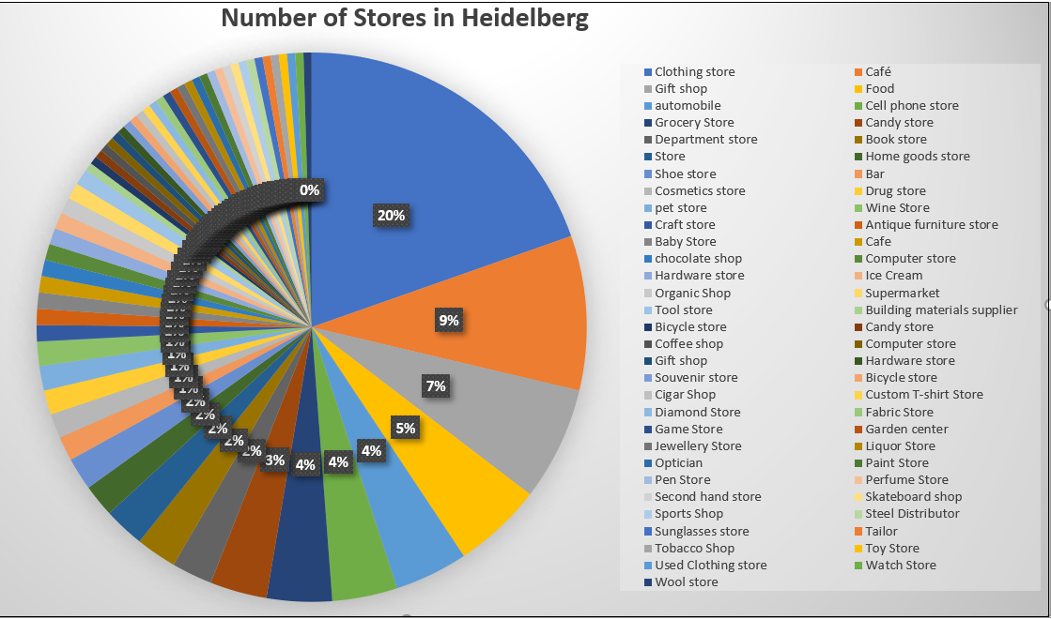
Market Analysis
More than 210 shops in Heidelberg.
Around 20% of these shops are clothing stores, 10-15% are Restaurants and Cafes. These stores don’t have any online presence.
Apps already in use for a specific genre of markets but no one stop shop.
Large corporations having one day rush deliveries even for non essential items.
10.05.2021

Slide 6


Target State
Vocal for local – The main objective is to provide an online platform for small shop owners of Heidelberg City to compete with larger manufacturers in the respective industries.
To encourage customers to buy from local shops
To decrease dependency on bigger platforms such as Amazon etc.
To help the Heidelberg city for having a convenient online platform for buying products offered by local shops
Be a part of the initiative to reduce pollution and save the environment by using appropriate resources for delivery such as electric cars.
10.05.2021

Slide 7
Requirements
Resource Requirements
Technical Requirements
Customer Requirements
Operational Requirements
Functional Requirements
10.05.2021

Slide 8
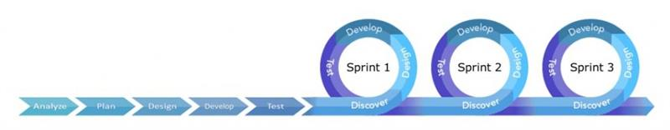
Methodology
In our project we will be using a blend of waterfall and agile methodologies as both of these methodologies are inverses of one another and hence combining them would help in reducing the overall drawbacks. Process which are interdependent would be done in waterfall while processes which need constant feedback and have a higher probability for changes would be done in agile, this would reduce our overall overheads significantly.
10.05.2021

Slide 9
The MoSCoW Analysis
17 Must Have
Location/GPS
Shop List with details and Address
Menu Bar
Filter by distance/ reviews/rating
View Product List
Product Page (Price Rating and description)
Cart
Login/Registration Single Sign on
Authentication by email/otp
Payment options
Delivery Categories
Add shop/ Add existing website link
Add/ List Products
Terms and Conditions for Del exc.
Accept Orders for shops and delivery
Order Confirmation
Api to Send news information/Shop and Logistics database
12 Should Have
Search by name pin code and category
Add Reviews
View Reviews of shops
Wishlist
Edit/Delete products
Register vehicle
Daily opening and closing timings
Sale and other offers
Order Tracking
Click and Collect
If Location is not allowed Use Approximate location using x y coordinate positioning
Barcode Scanner to show all the products
3 Nice to Have
Pin/Make a shop as your favorite
Use Coupons/Avail Discounts
Notifications from Shops to customers
10.05.2021

Slide 10
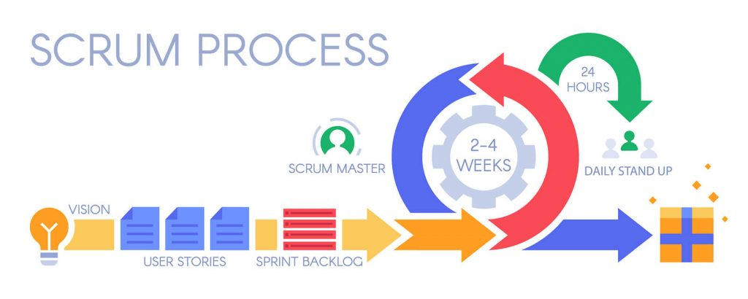
Use Cases with Scrum Process
Use Case 1
Sprint Number : 1
Author | Business Analyst
Title | Location/ Gps
Stakeholder | Customers(Citizens,Tourists)
Use CaseDescription | Every User will have to give access of their location to the app for better and easier shop/ service search
NormalFlow | 1. User Opens the app 2. User is asked for the Gps/location permissions
Title | Description
Location/ Gps | Every User will have to giveaccess of their location to theapp for better and easiershop/ service search
10.05.2021

Slide 11
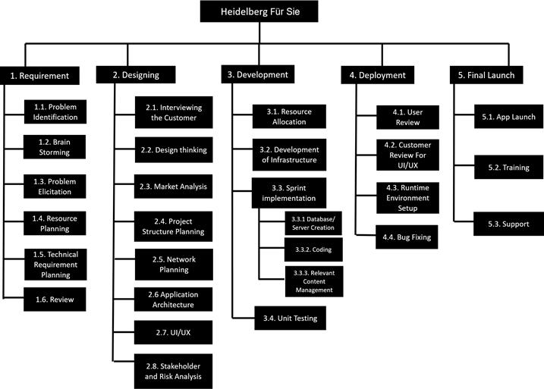
Project Process Model
10.05.2021

Slide 12
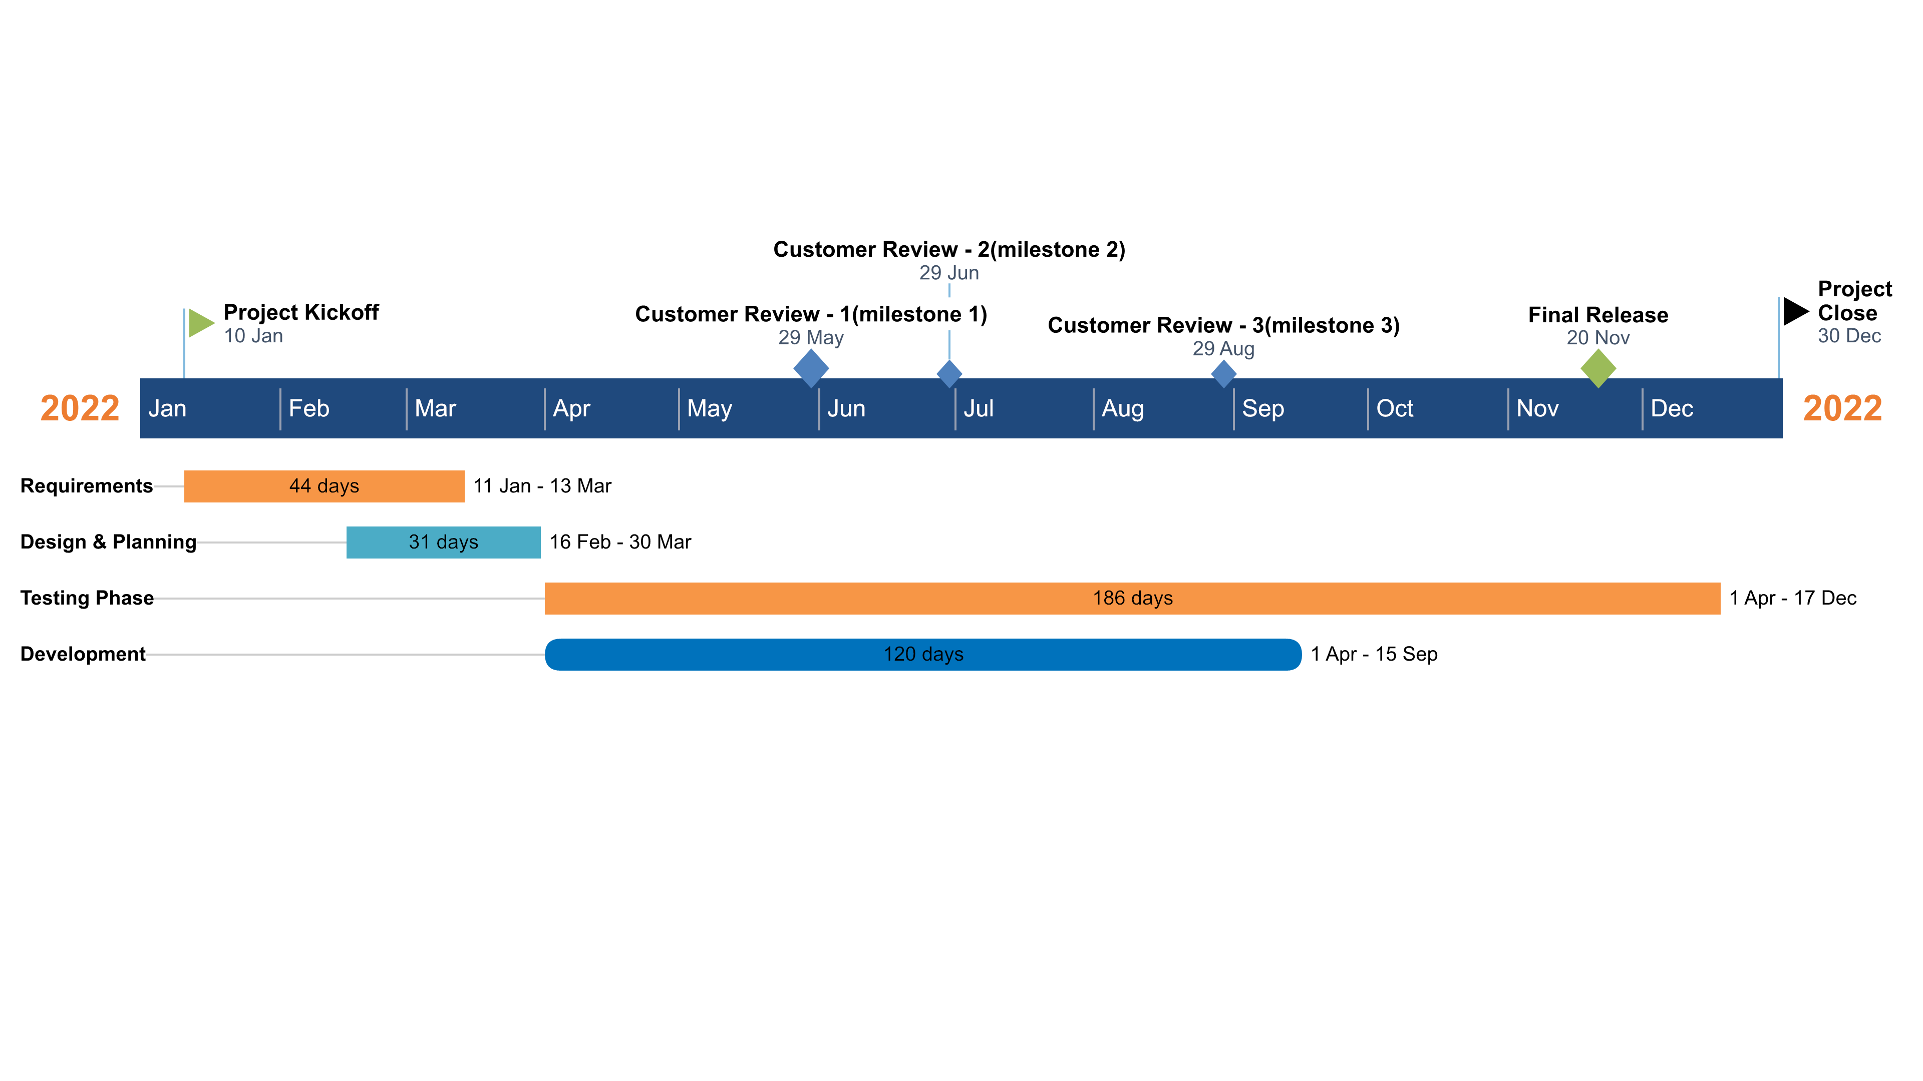
Milestones
10.05.2021

Slide 13
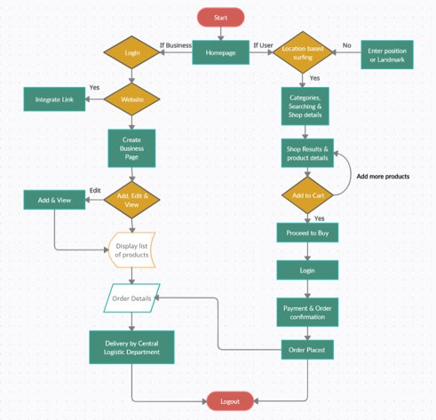
Application Flow Chart
10.05.2021

Slide 14
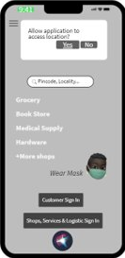
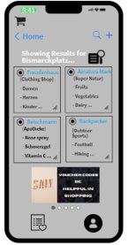
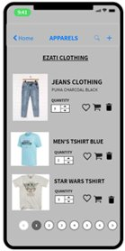
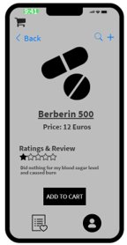
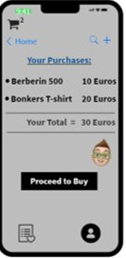
User Interface Design
Homepage
Search Results
Product List
Product details
Cart details
10.05.2021

Slide 15
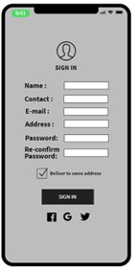
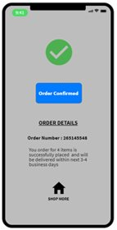
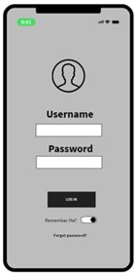
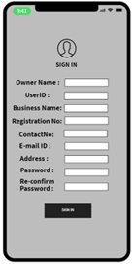
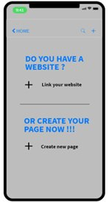
User Interface Design
Sign Up for Customer
Order Confirmation
Login Page
Sign Up for Business
Website/Create Page
10.05.2021

Slide 16
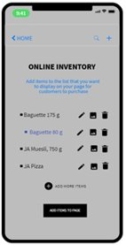
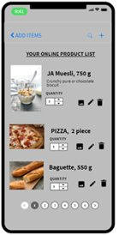
User Interface Design
Edit, Add & View for Business
Product List
10.05.2021

Slide 17
Risk Analysis
Risk | Criticality | Probability | Score | Mitigation Strategy
InsufficientRequirements | 4 | 2 | 8 | Mitigation
ImproperCoordination | 4 | 2 | 8 | Mitigation
Insufficientresources | 3 | 1 | 3 | Avoidance
Complex UI | 4 | 3 | 12 | Mitigation
Team Changes | 3 | 2 | 6 | Avoidance
Low Customer Interest | 4 | 2 | 8 | Mitigation
Wrong ShopInformation | 3 | 4 | 12 | Mitigation
10.05.2021

Slide 18
Risk Analysis
Risk | Criticality | Probability | Score | Mitigation Strategy
No Permission to use Gps/location | 2 | 2 | 4 | Mitigation
Address andtimings notgettingupdated | 3 | 2 | 6 | Delegation
Payment Gateway notworking | 4 | 3 | 12 | Delegation
Existing Shops not gettingintegrated | 1 | 2 | 2 | Avoidance
InsufficientDatabase | 4 | 4 | 16 | Mitigation
10.05.2021

Slide 19
Risk Analysis
Risk | Criticality | Probability | Score | Mitigation Strategy
Authentication Error | 4 | 1 | 4 | Mitigation
Data Breach | 4 | 2 | 8 | Delegation
Malwares | 4 | 2 | 8 | Delegation
ApplicationCrash | 4 | 2 | 8 | Delegation
10.05.2021

Slide 20
Stakeholder Analysis
Stakeholders | Influence | Interest | Attitude
SRH Hochschule | 4 | 4 | Positive
City of Heidelberg/Mayor | 4 | 4 | Positive
Citizens of Heidelberg | 2 | 4 | Positive
Tourists | 1 | 3 | Positive
Shop Owners | 3 | 3 | Positive
Logistics | 3 | 3 | Positive
Business Analyst | 4 | 2 | Positive
Developers | 4 | 2 | Positive
Project Manager | 3 | 2 | Positive
UI/UX | 4 | 2 | Positive
Competitors | 1 | 4 | Negative
Legal Team | 3 | 2 | Positive
10.05.2021

Slide 21
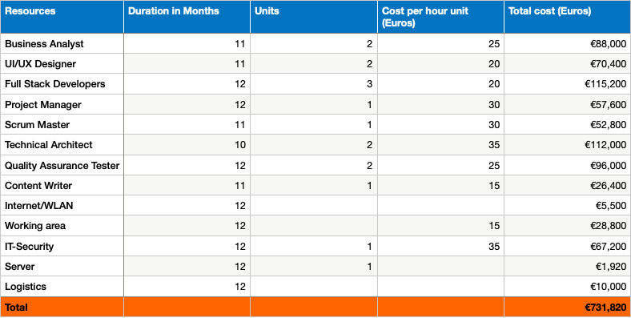
Cost Estimation of the Project
10.05.2021

Slide 22
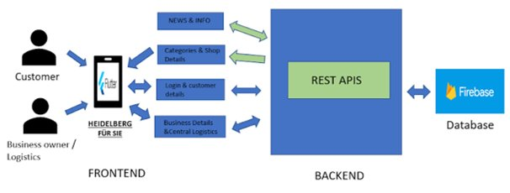
Technology Used
10.05.2021

Slide 23
Advantages of mobile application:
User friendly and provides unique user experience
Provides personalized experience
Safe and Secure
Provides better reach by using features like geolocation and push notifications
Users spend more time on cell phones than browsers, average daily time spent is 132 minutes
Users can apply patches/updates
Have access to system resources such as camera or GPS
Disadvantages of mobile application :
Needs downloading and installation
Poor discoverability, difficult to find through search engines - has dependency on App stores
Platform Compatibility - Mobile Application development is expensive because they have to be implemented according to different platforms (iOS, Android)

Slide 24
REFERENCES
Image:https://www.google.com/search?q=vocal+for+local&sxsrf=ALeKk00s6hOMluAOD8pcwa7ddBDOxRnIFw:1620641011134&source=lnms&tbm=isch&sa=X&ved=2ahUKEwiflJue7r7wAhWogf0HHWFyD_gQ_AUoAXoECAEQAw&biw=1536&bih=666#imgrc=-RTmvt2uW8qYzM
https://www.heidelberg24.de/bilder/2020/04/21/13683798/261331204-einen-nach-lockerungen-corona-massnahmen-noch-wenig-los-2uQIjHSg9Vec.jpg

Slide 25
THANK YOU FOR LISTENING
DO YOU HAVE ANY QUESTION?

